Slide 1
Intel - ocr

Slide 2
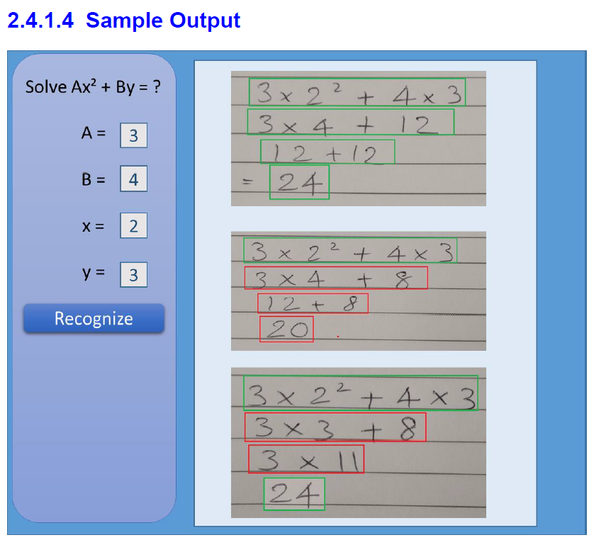
Problem Statement
The overall idea behind this project is to develop an computer vision algorithm along with solution package for recognizing and digitizing steps of solving a mathematical equation written by freehand on a paper, validating the steps and final answer of the recognized handwritten lines by maintaining the context

Slide 3
1. Tasks Completed
1.1 Workspace, Line, Character, Exponential Detection
1.2 Character recognition - Deep Learning Model Building
1.3 Computing mathematical equation value and Drawing boxes
1.4 Checking validation of equation mathematically
2. Inputs from Intel [ For tuning Parameters ]
2.1 Sample Image Testing
✔
✔
✔
✔
✔

Slide 4
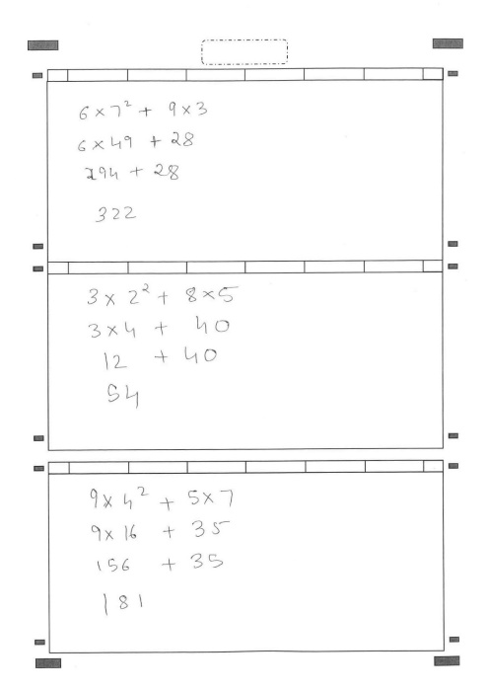
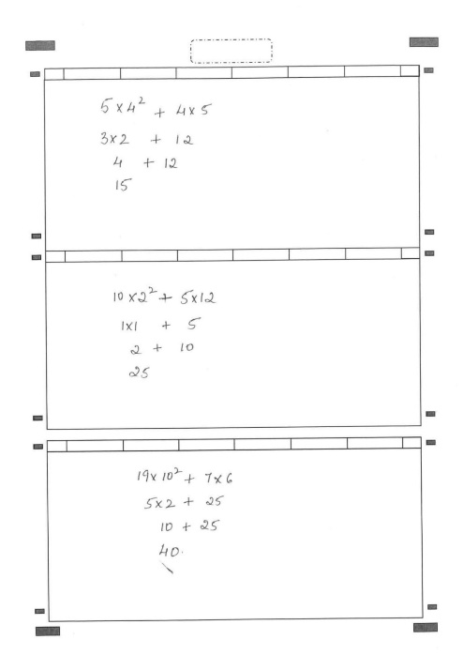
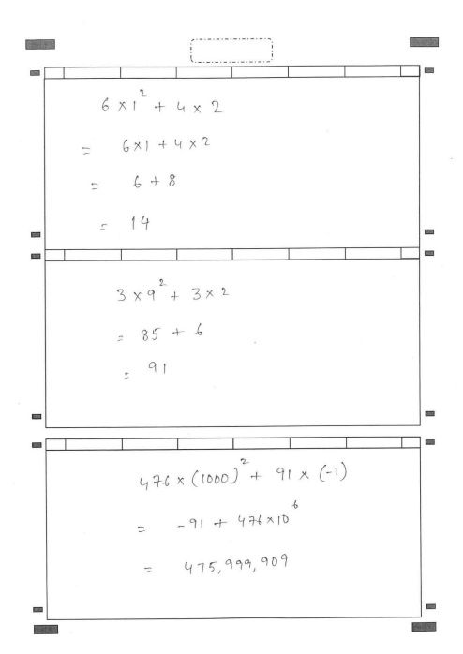
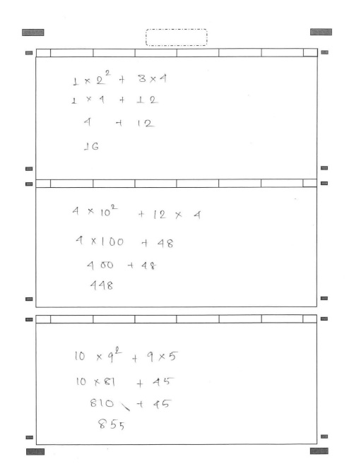
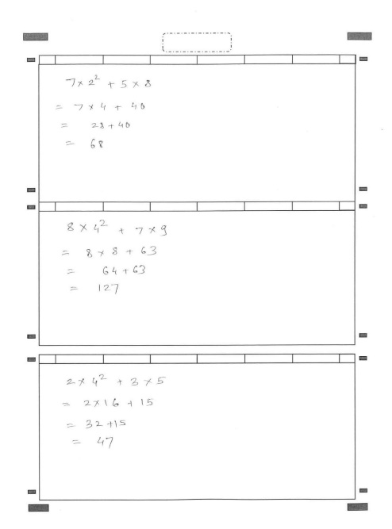
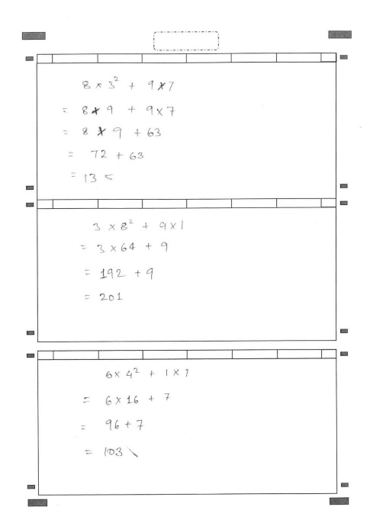
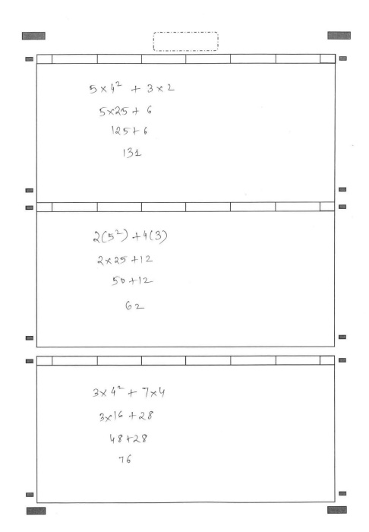
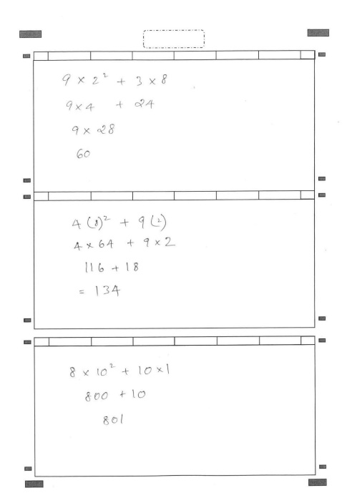
Testing
No. of Image Received : 8 Format : .pdf
Resolution : 1627 * 2300
Converted to jpeg
Issues Spotted in Images Which affects accuracy :
1. Quality : Low ( Just 100 dpi, requires >300 dpi for best accuracy )
2. Big Commas, Cut Marks, Over Writing
3. Joined Characters
4. Different equation in all boxes

Slide 5
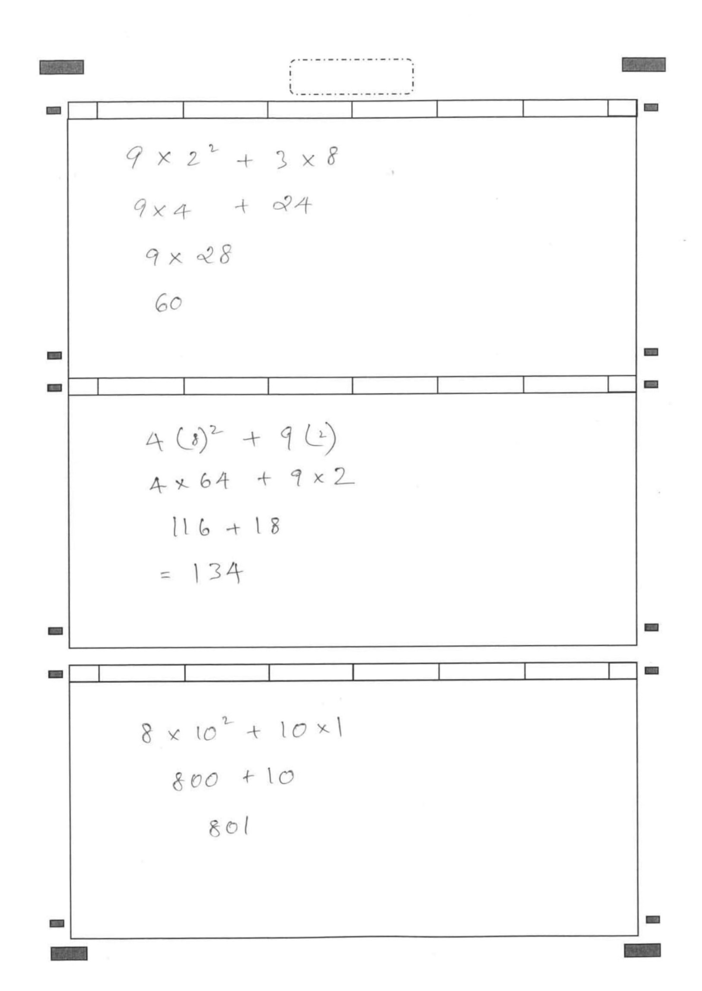
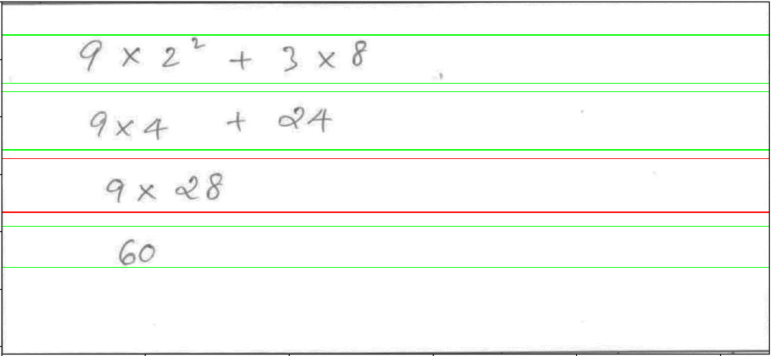
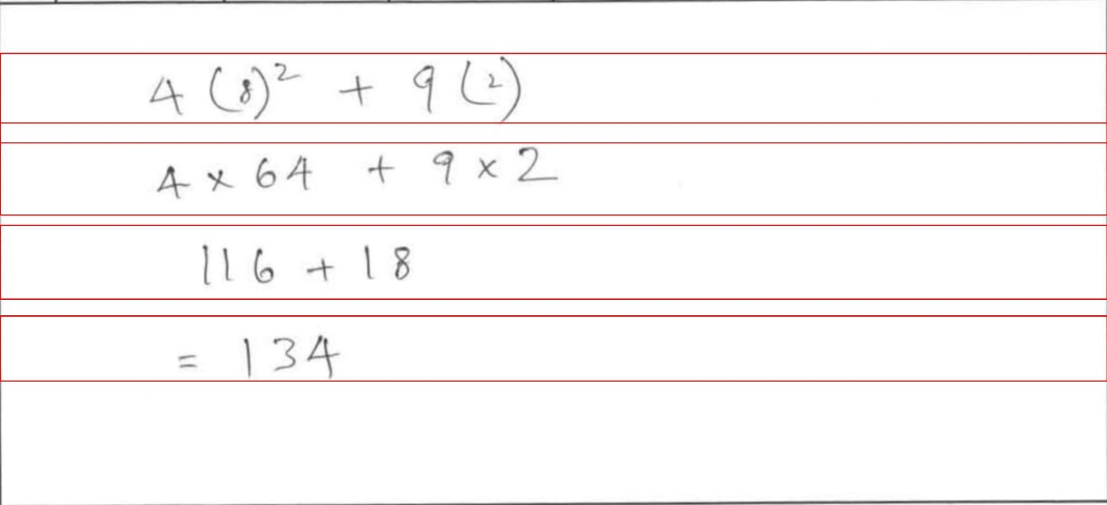
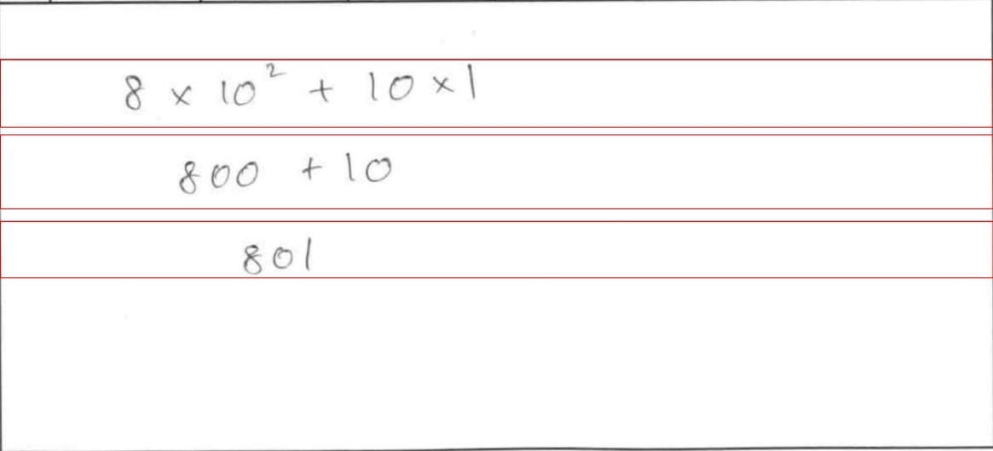
Image 1
Test Results
BOX 1
>>9*2**2+3*8
>>9*4+24
>>9*28
>>60
BOX 2
>>4*(8)**2+9*(2)
>>4*64+9*2
>>116+18
>>134
BOX 3
>>8*10**2+10*1
>>800+10
>>801

Slide 6
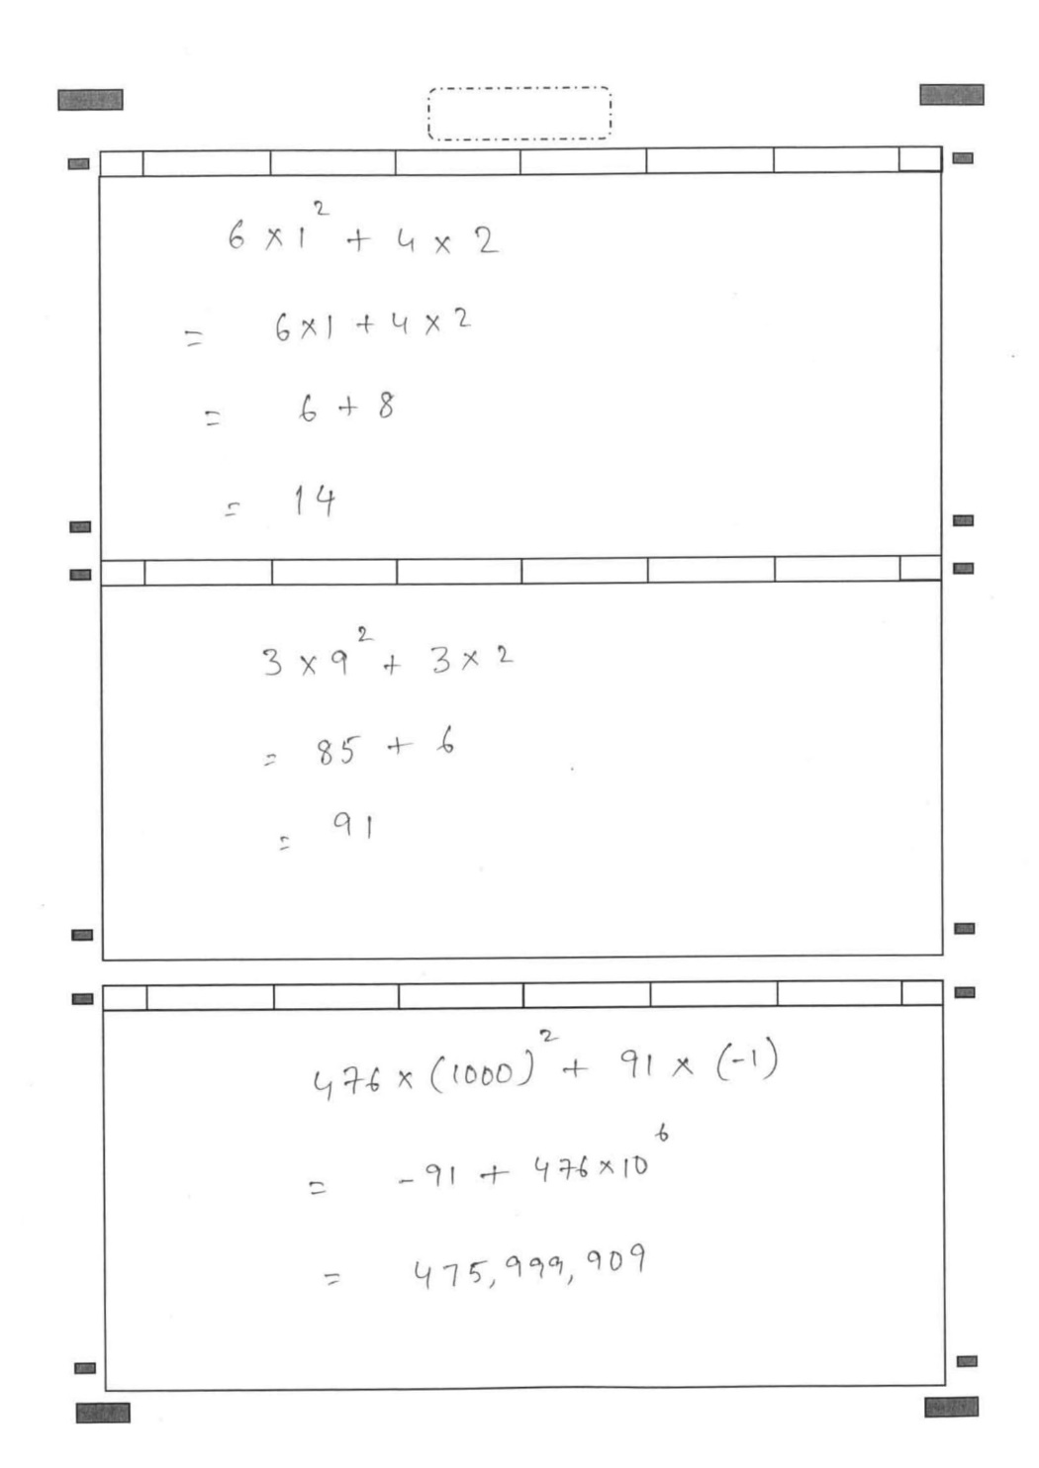
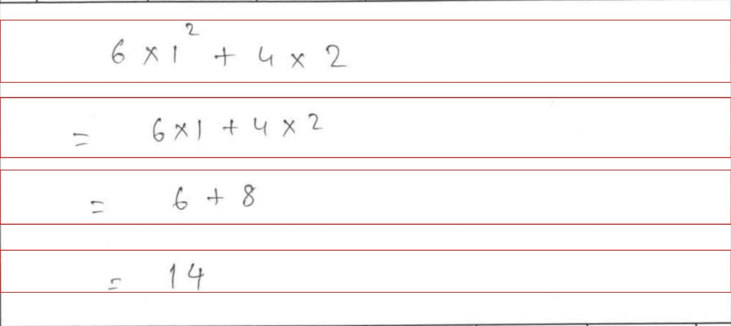
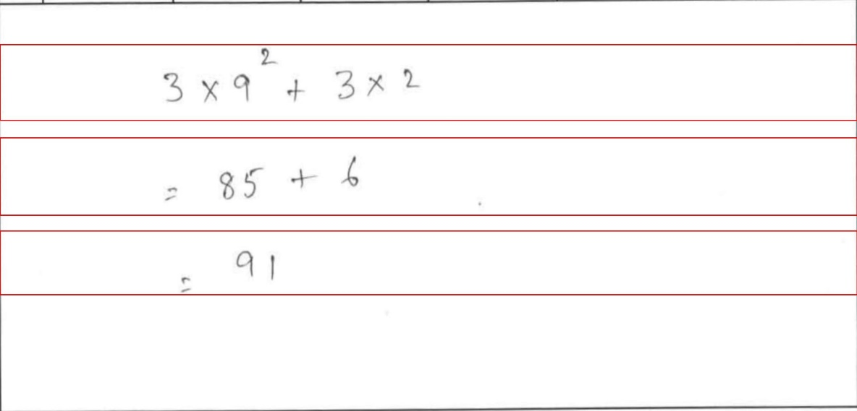
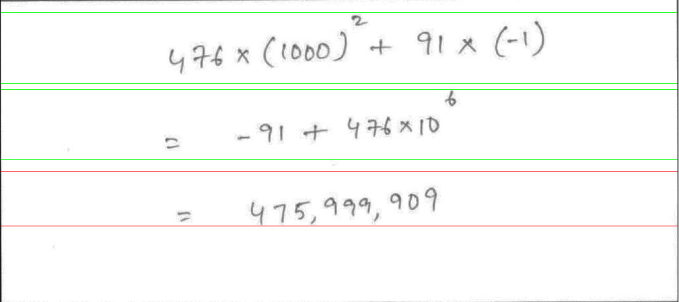
Image 2
Test Results
BOX 1
>>6*1**2+4*2
>>6*1+4*2
>>6+8
>>14
BOX 2
>>3*9**2+3*2
>>85+6
>>91
BOX 3
>>476*(1000)**2+
91*(-1)
>>-91+476*10**6
>>47519991909

Slide 7
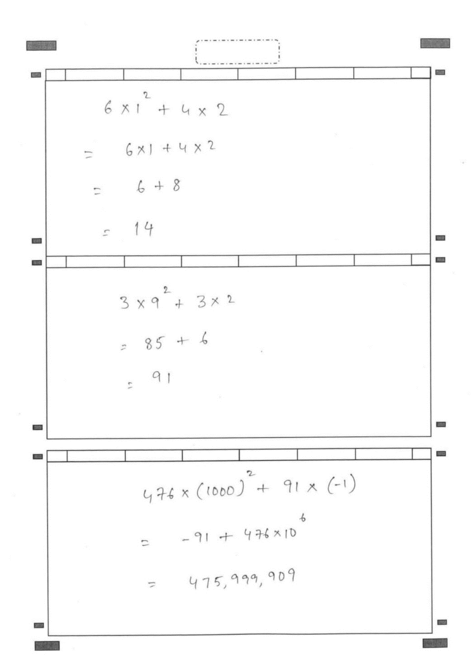
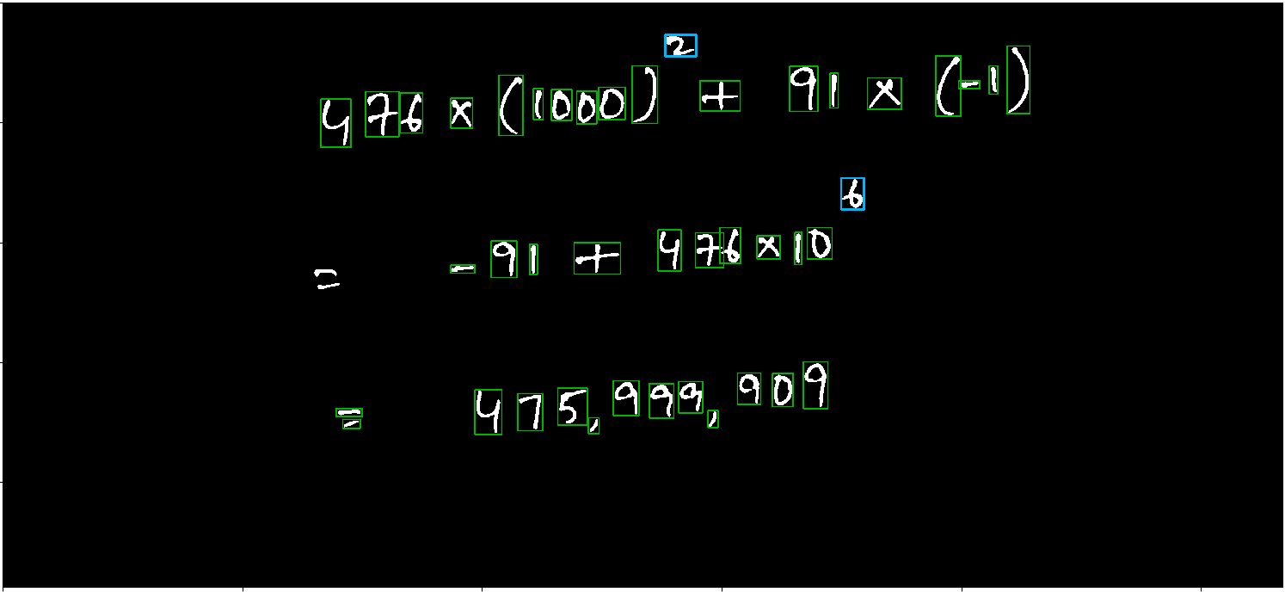
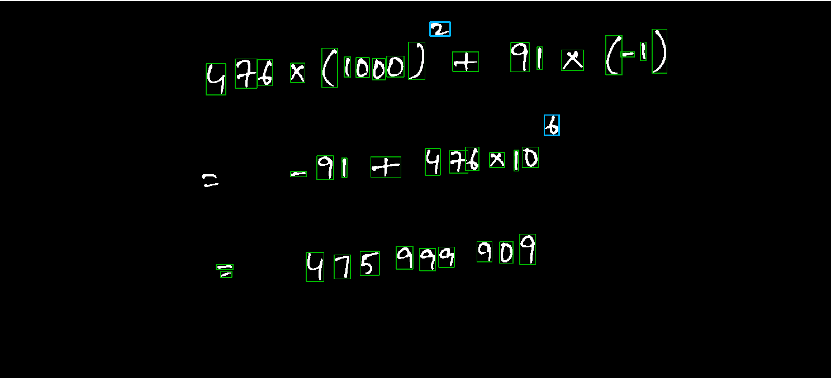
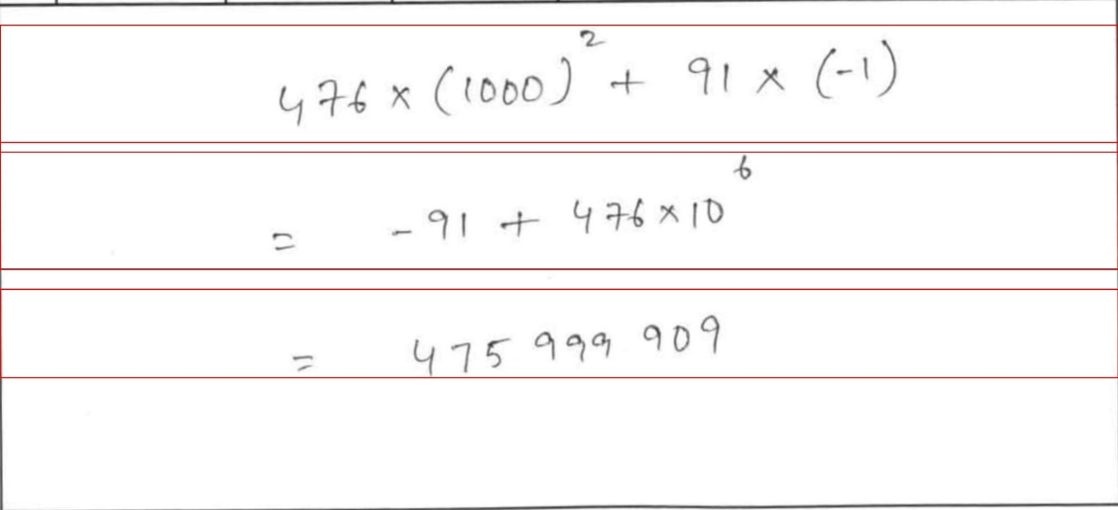
Image 2- Comma Remove and Test : Pass
Test Results
BOX 1
>>6*1**2+4*2
>>6*1+4*2
>>6+8
>>14
BOX 2
>>3*9**2+3*2
>>85+6
>>91
BOX 3
>>476*(1000)**2+
91*(-1)
>>-91+476*10**6
>>475999909

Slide 8
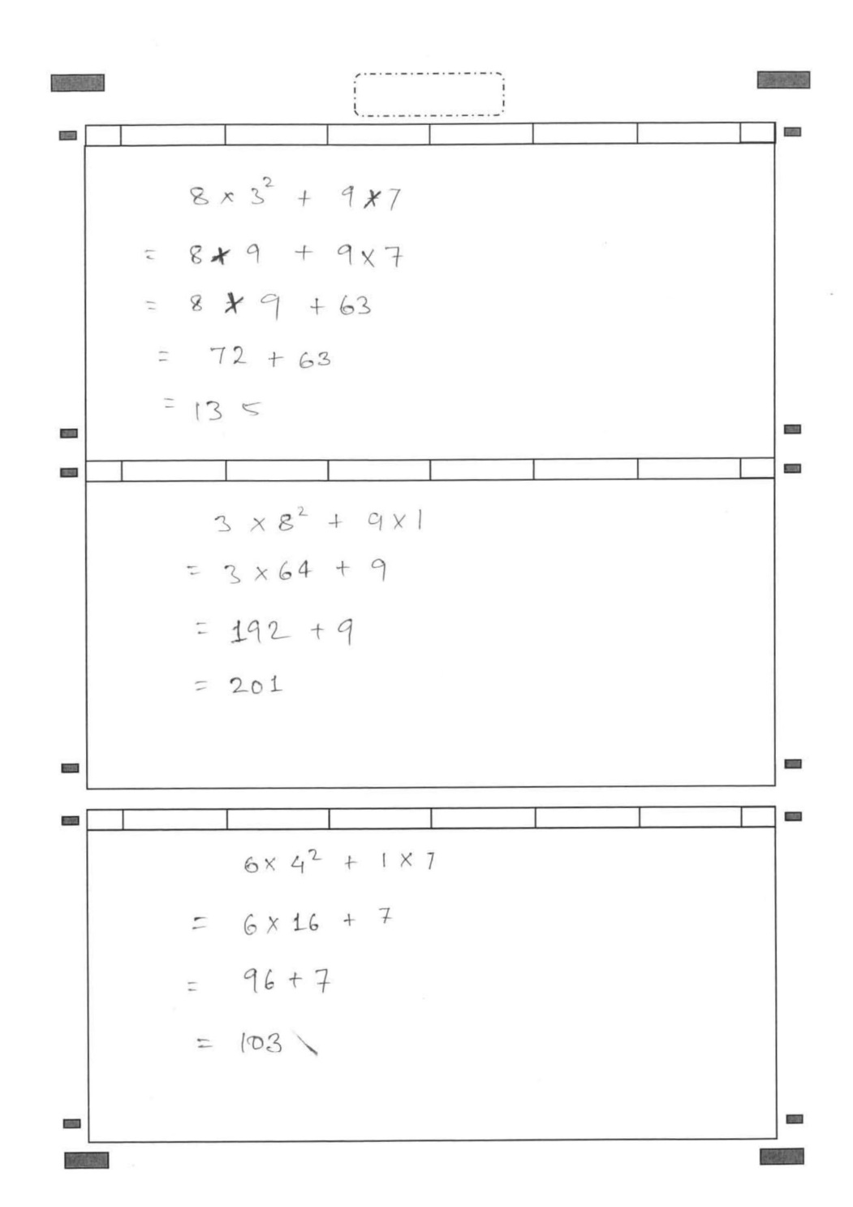
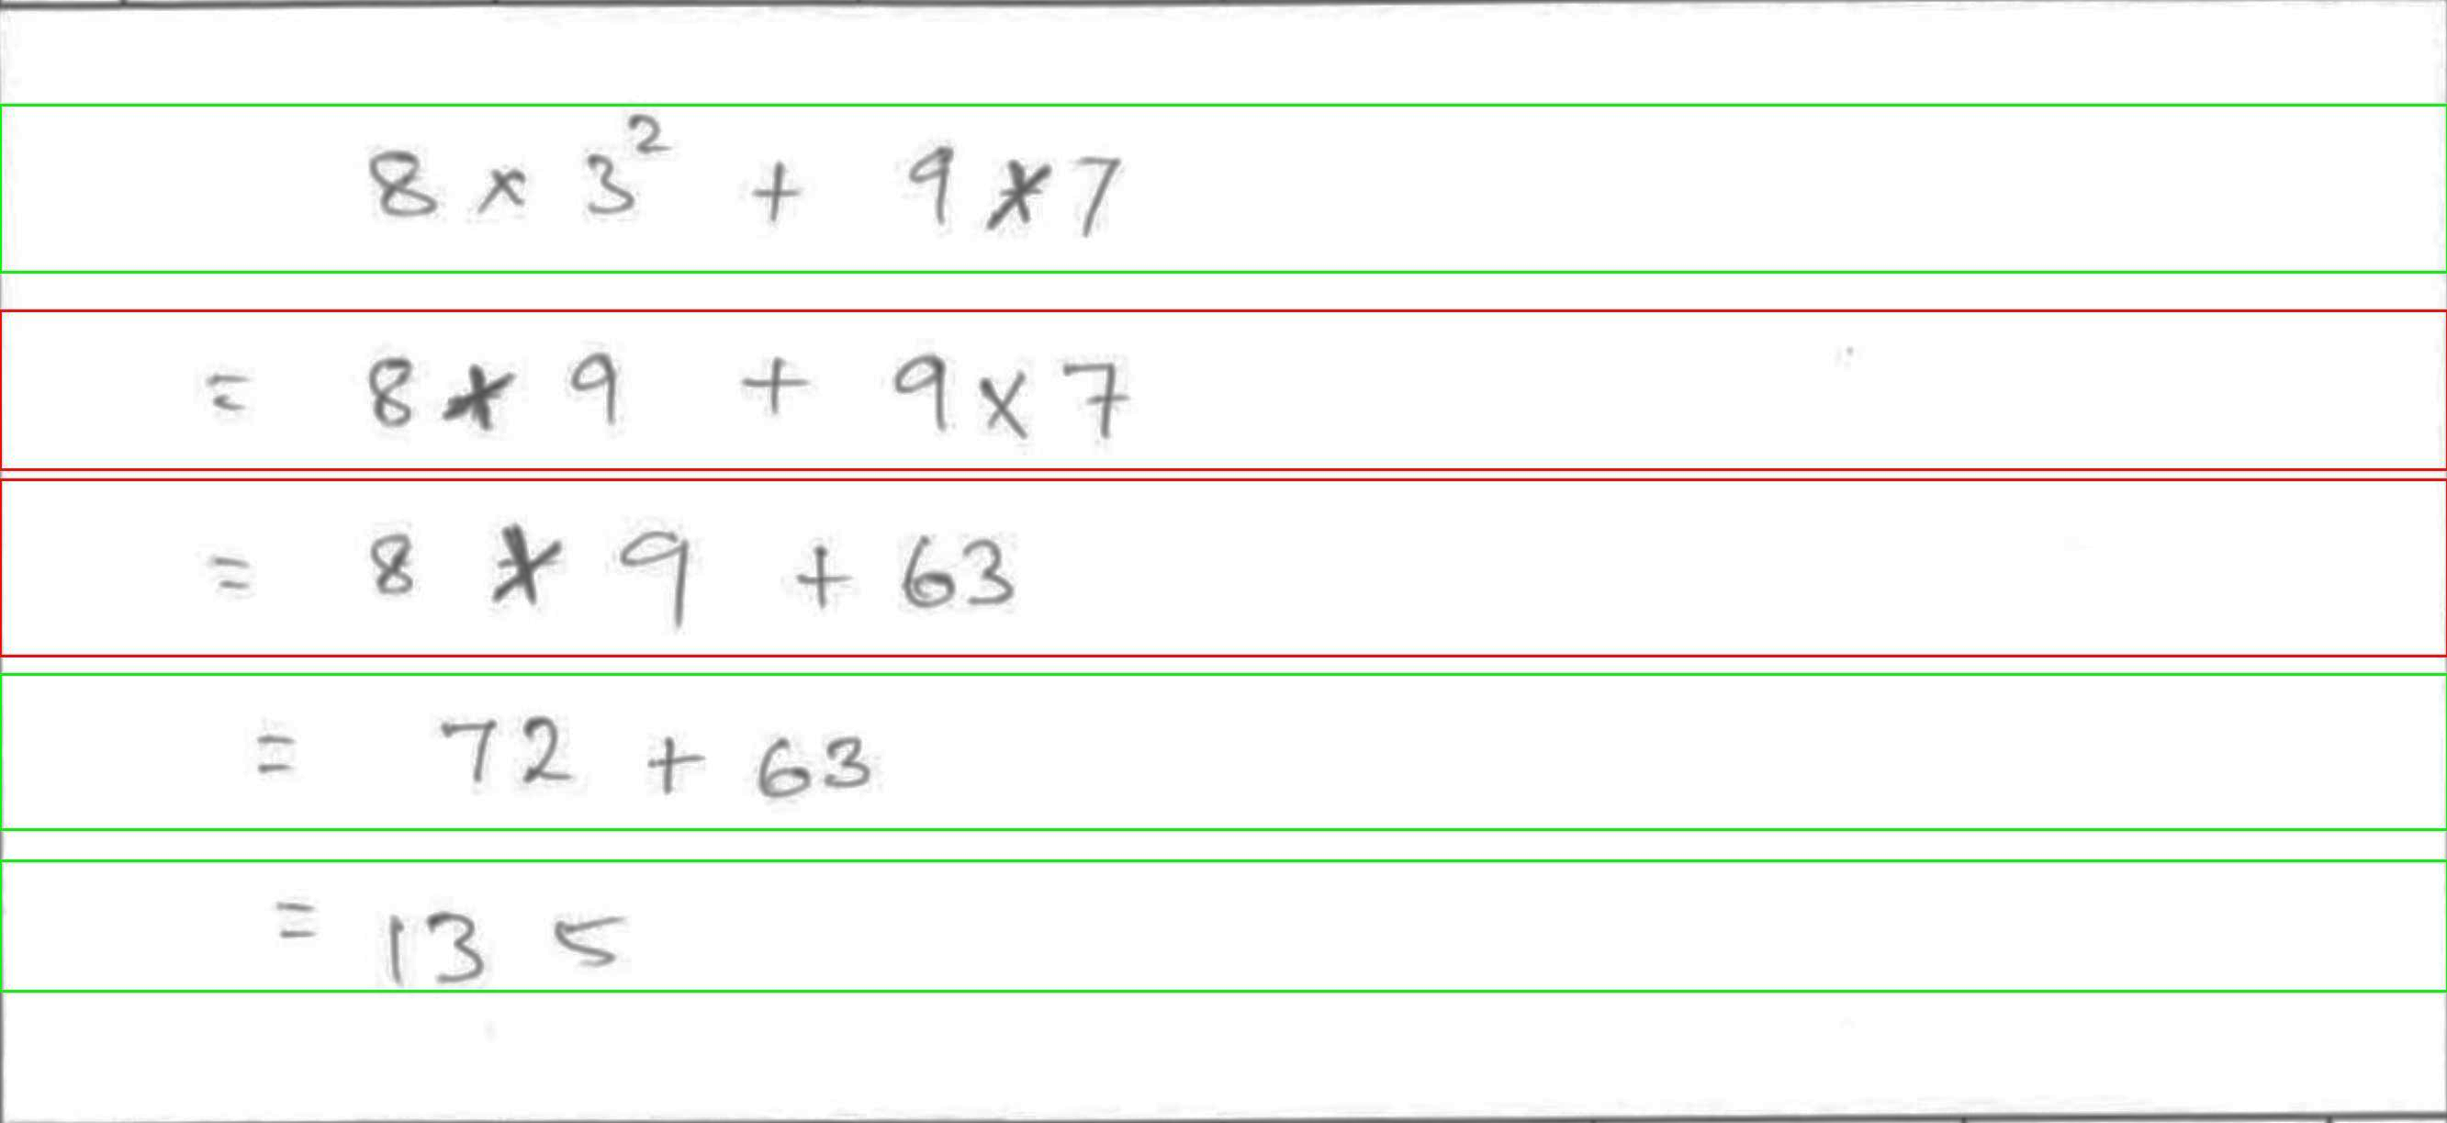
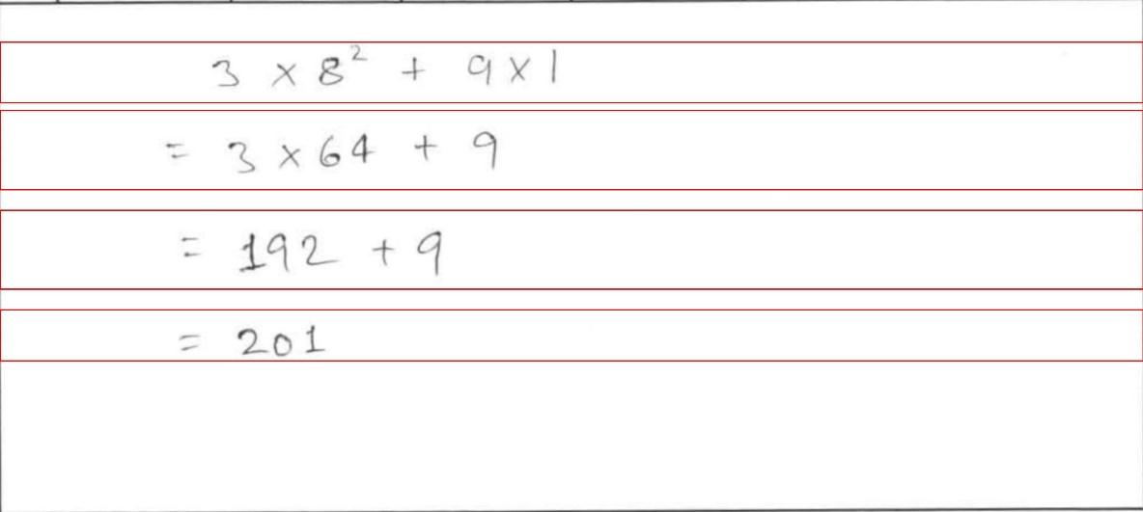
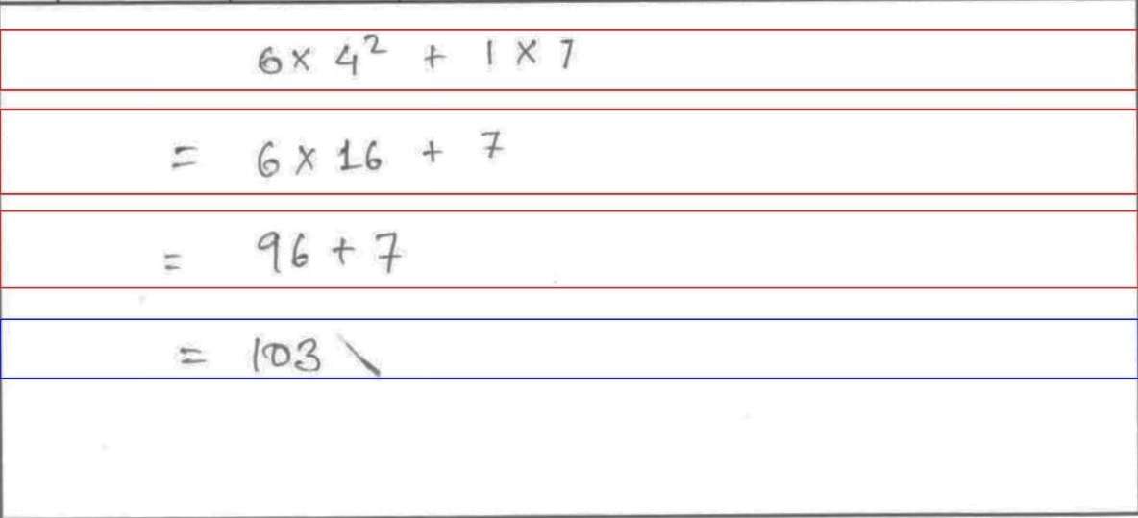
Image 3
Test Results
BOX 1
>>8*3**2+9*7 >>8+9+9*7
>>-8*9+63
>>72+63
>>135
BOX 2
>>3*8**2+9*1
>>3*64+9
>>192+9
>>201
BOX 3
>>6*4**2+1*7
>>6*16+7
>>96+7
>>1023*

Slide 9
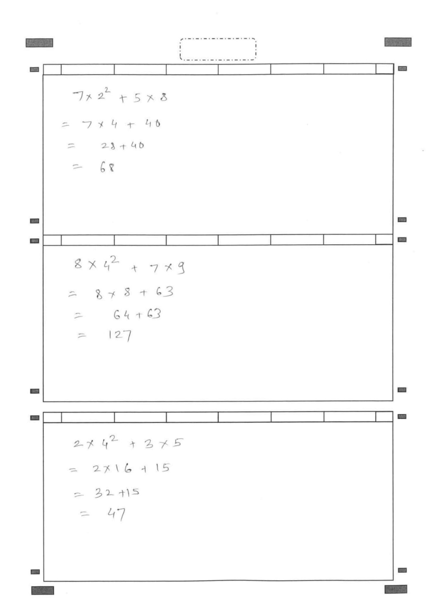
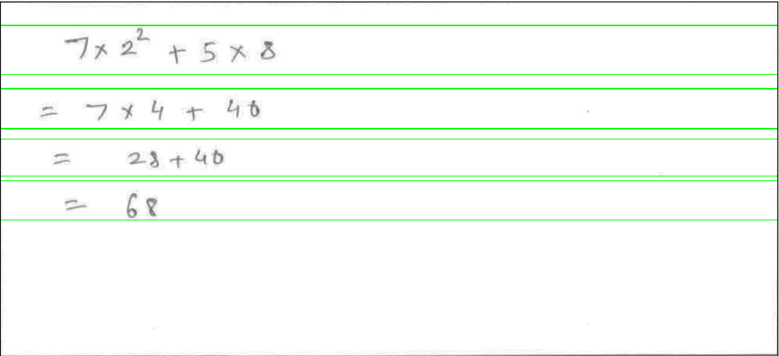
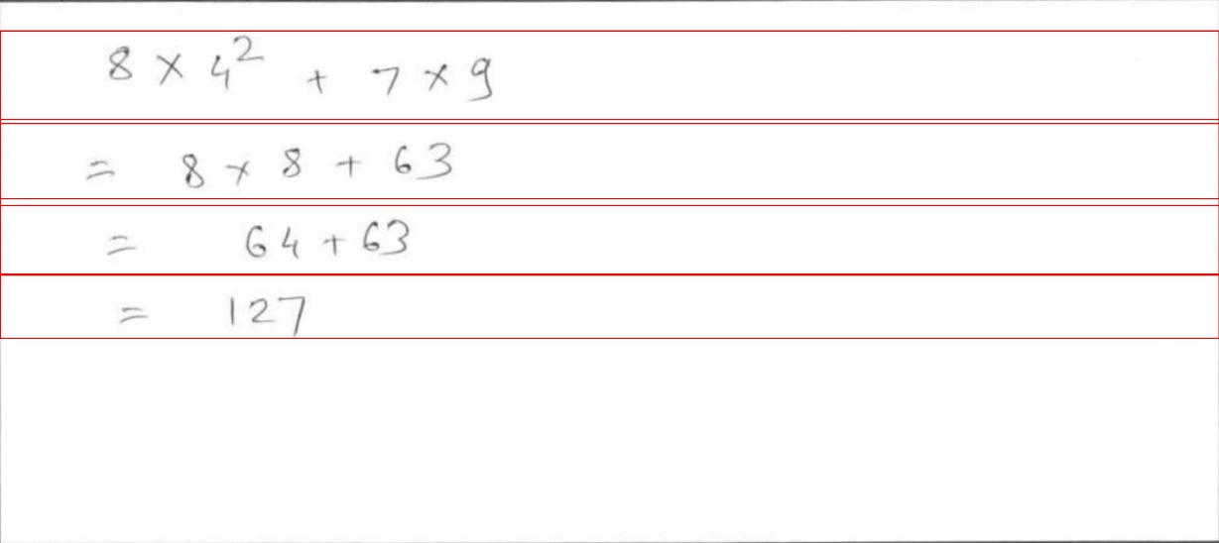
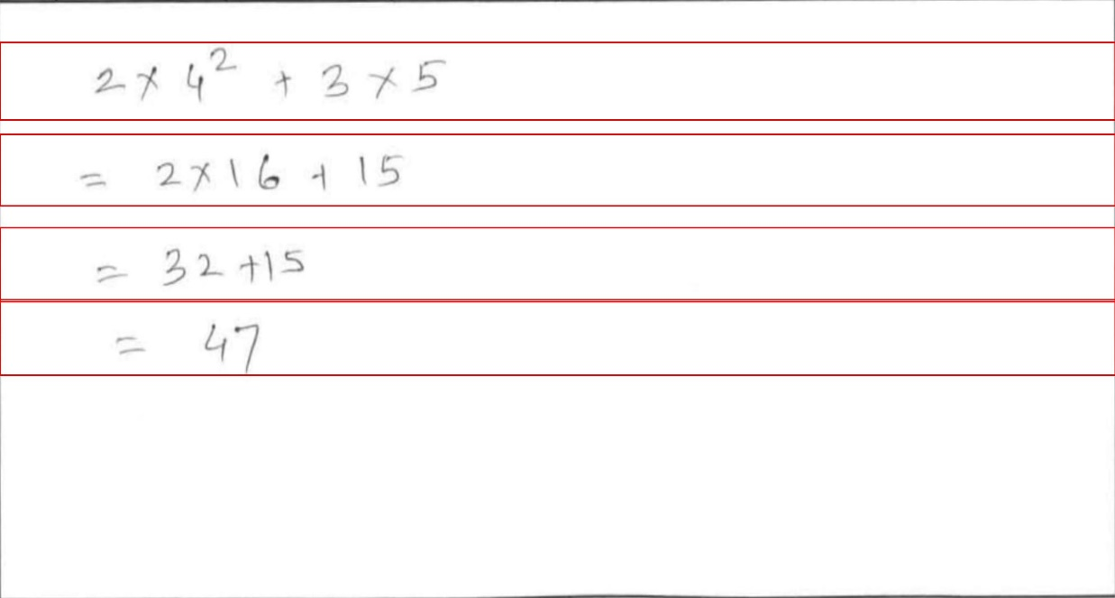
Image 4
Test Results
BOX 1
7*2**2+5*8
7*4+40
28+40
68
BOX 2
8*4**2+7*9
878+63
64+63
127
BOX 3
274**2+375
2716+15
32+15
47

Slide 10

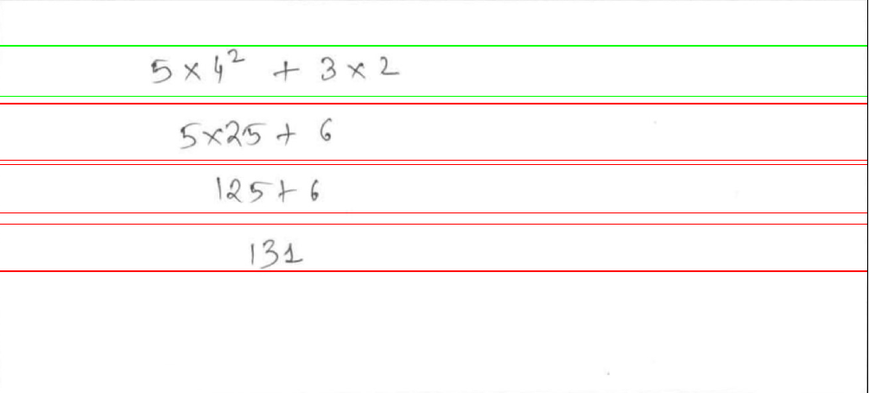
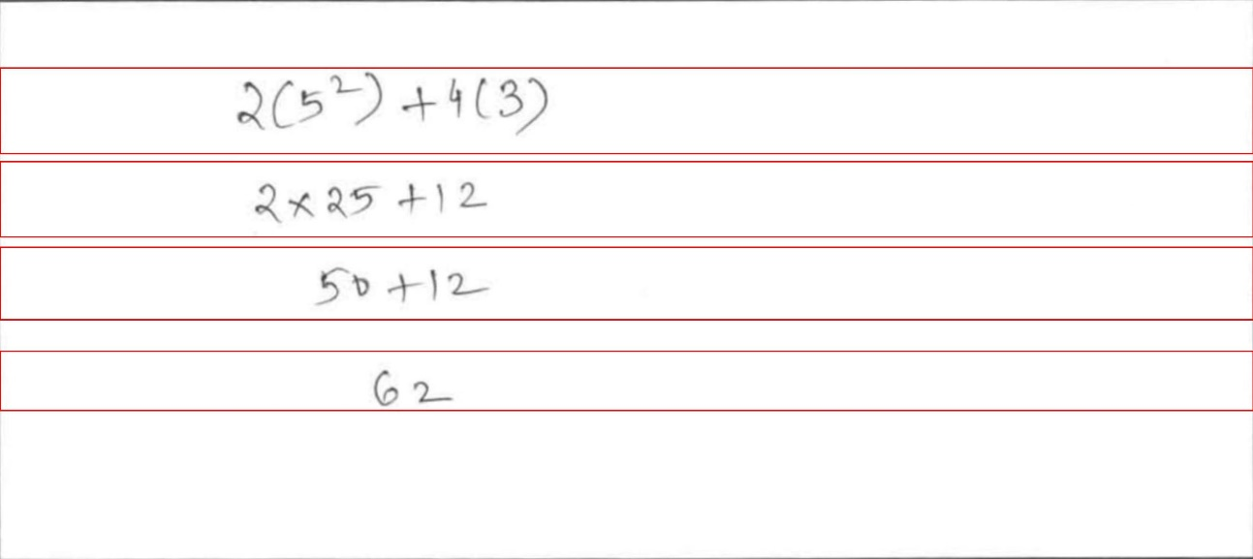
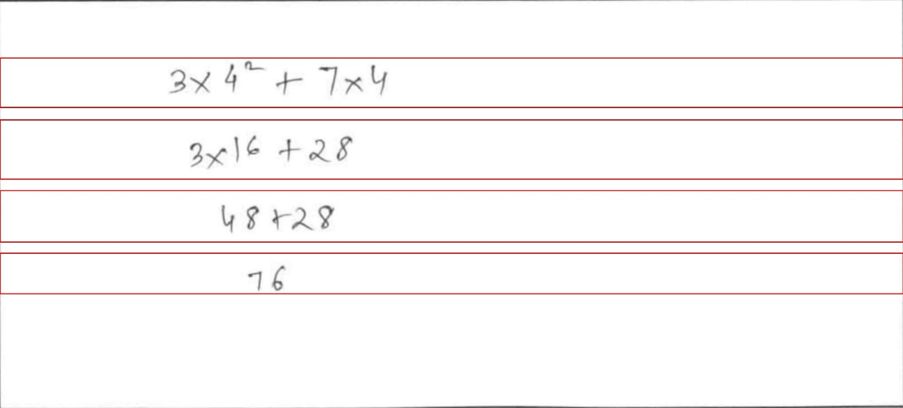
Image 5
Test Results
BOX 1
5*4**2+3*2
5*25+6
125+6
132
BOX 2
2*(5**2)+4*(3)
2*25+12
58+12
62
BOX 3
3*4**2+7*4
3*16+28
48+28
76

Slide 11
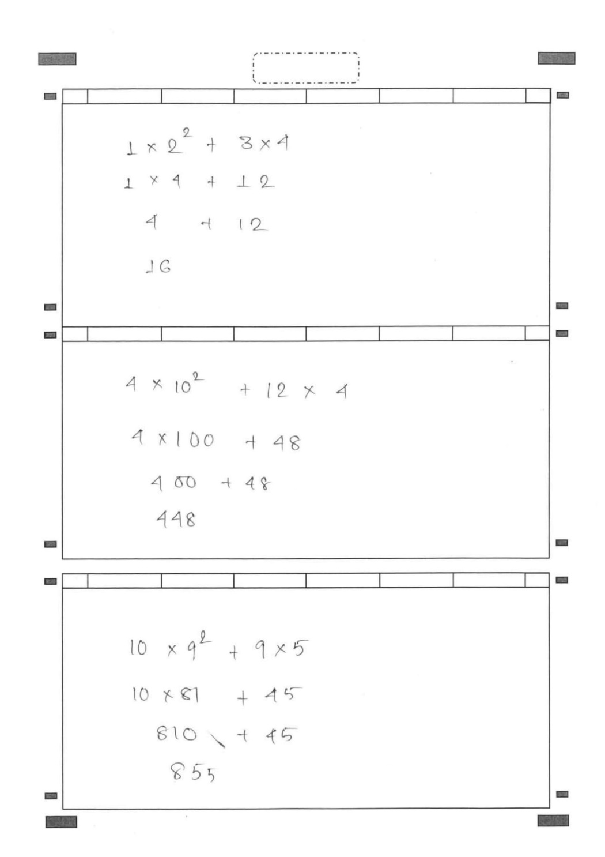
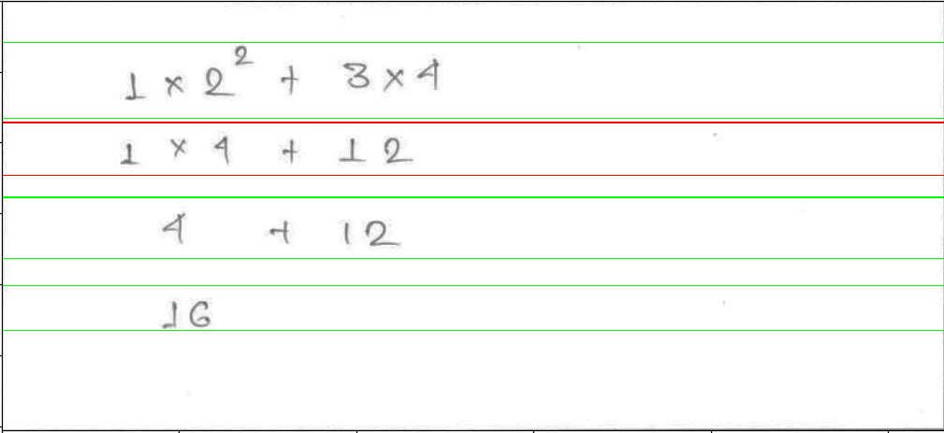
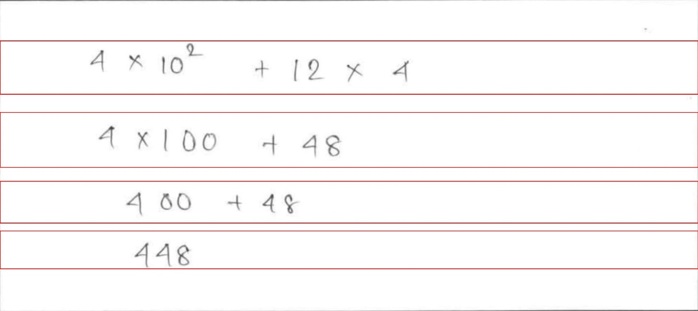
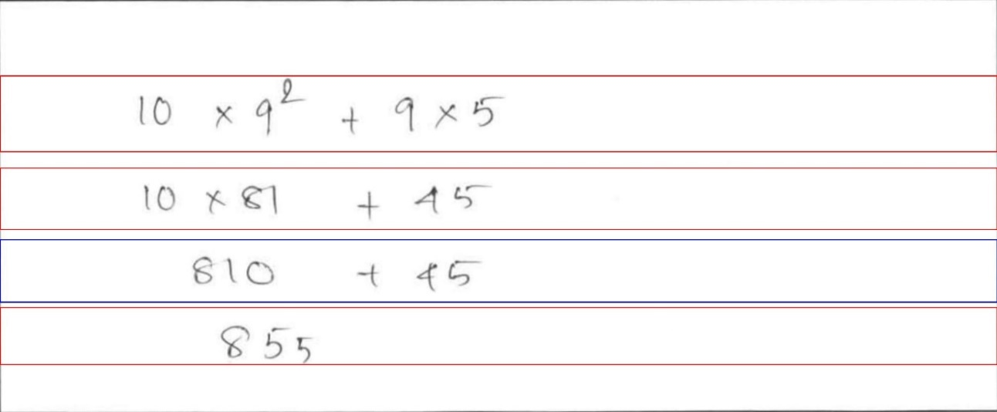
Image 5
Test Results
BOX 1
1*2**2+3*4
2*4+22
4+12
16
BOX 2
4*10**2+12*4
4*100+48
46+48
448
BOX 3
10*9**2+9*5
10*0+45
810*+45
855
Errors
Joined Chars
Big noise

Slide 12

Image 5
Test Results
BOX 1
1*2**2+3*4
2*4+22
4+12
16
BOX 2
4*10**2+12*4
4*100+48
400+48
448
BOX 3
10*9**2+9*5
10*81+45
810+45
855
Errors
Removed
Manually for
Testing:
PASS

Slide 13

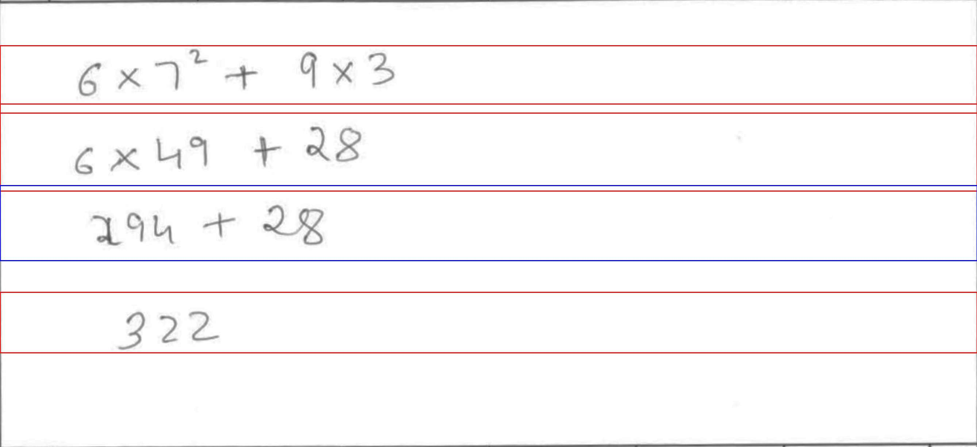
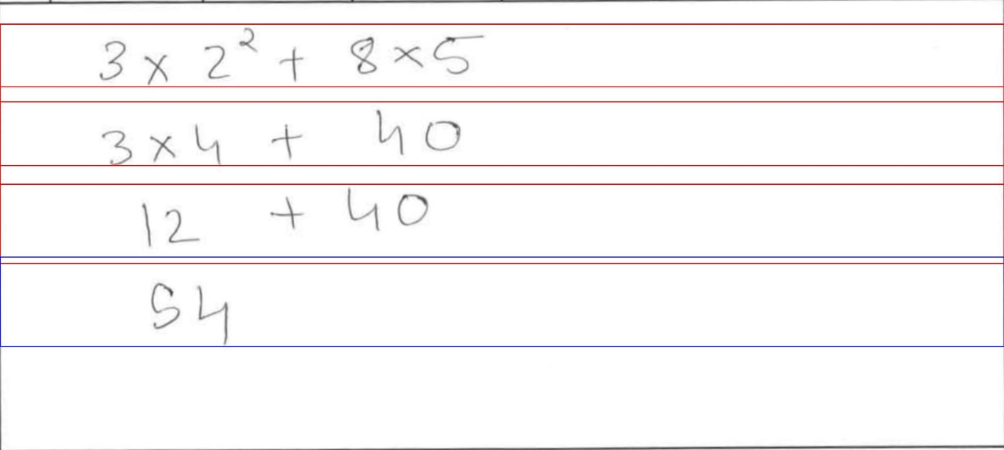
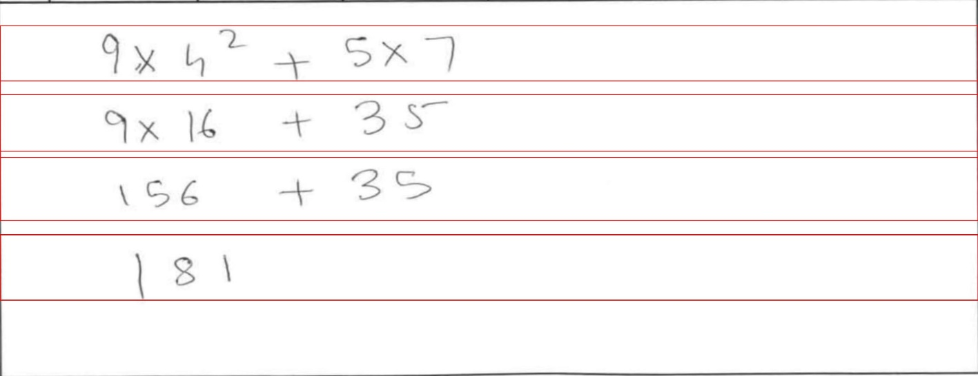
Image 6
Test Results
BOX 1
6*7**2+9*3
6*49+28
294+ +
unexpected EOF
while parsing (<unknown>, line 1)
322
BOX 2
3*2**2+8*5
3*4+40
12+40
54
BOX 3
9*4**2+5*7
9*16+35
156+35
181

Slide 14
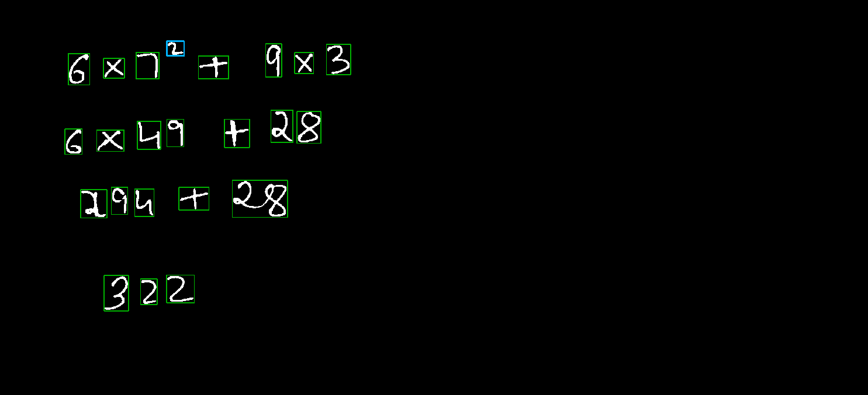
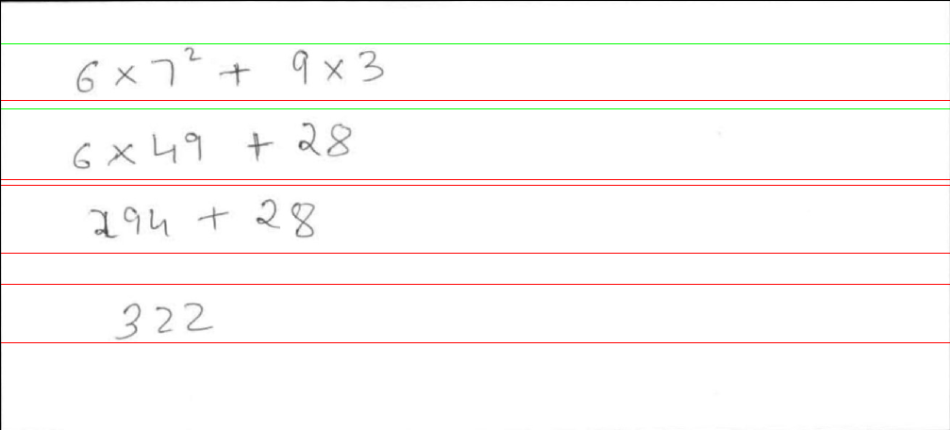
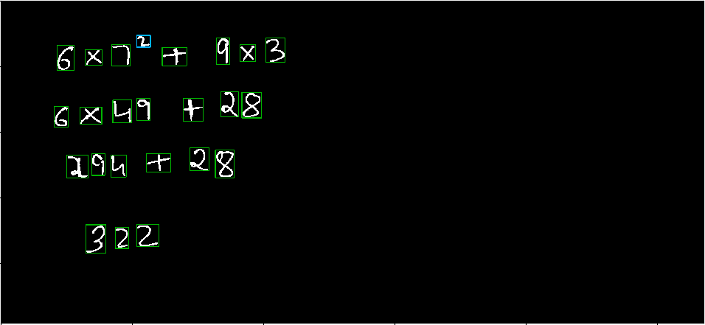
Image 6
Test Results
Errors
Removed
Manually for
Testing:
PASS
BOX 1
6*7**2+9*3
6*49+28
294+28
322
BOX 2
3*2**2+8*5
3*4+40
12+40
54
BOX 3
9*4**2+5*7
9*16+35
156+35
181
Manually Tested by removing error : PASS

Slide 15

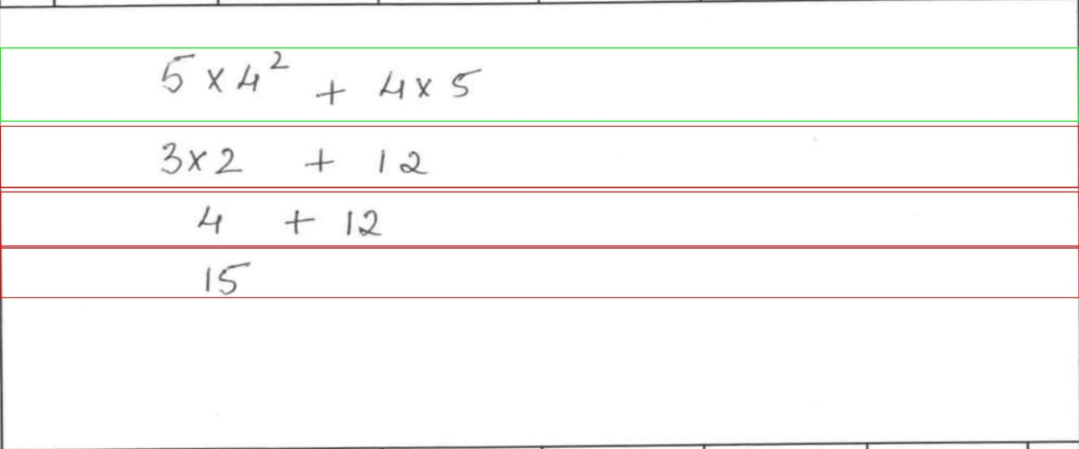
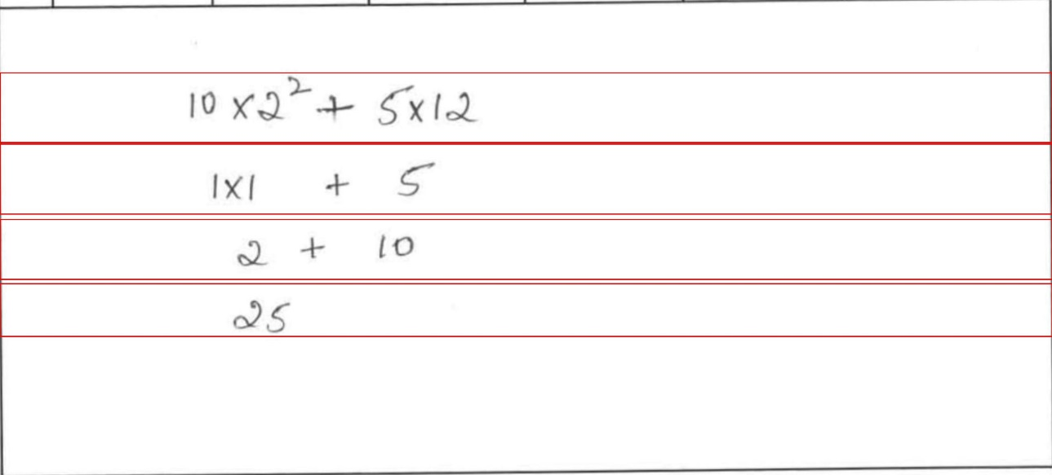
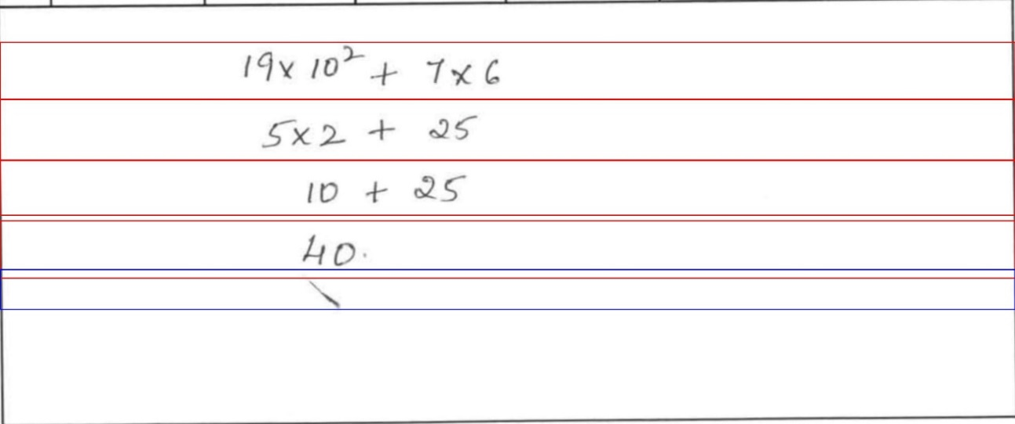
Image 7
Test Results
BOX 1
5*4**2+4*5
3*2+12
4+12
15
BOX 2
10*2**2+5*12
1*1+5
2+10
25
BOX 3
19*10**2+7*6
5*2+25
10+25
40

Slide 16
Accuracy
Total Lines : 94
Wrong Detection , Model Error : 8
Test Accuracy : 86/94 ~ 94 %

Slide 17
RFP vs Deliverables
Comparison
Requirements | Deliverables | Status
Accuracy Level > 90 % for intermediate and final steps Sample application in which take image input and provide image output with colored bounding boxes with Right or Wrong indication. Application should also generate detailed log file. Model files and weights. Training Files and Test Results User guide along with steps for integrating in a different application software. Hosting solution on github freely | Currently accuracy on handwritten images is >90 % for intermediate steps and > 90 % for Line detection Currently Sample application takes images as a input and provides images a output with right, wrong and undetermined colored bounding boxes. Image output is being saved in ‘logs’ folder with respective image name and timestamp. Prediction logs are present in server Model file and weights is being saved into ‘models’ folder Training files and test results are present in a jupyter notebook with each steps clearly mentioned User guide with steps has been provided Hosted solution in github
✔
✔
✔
✔
✔
✔

Slide 18
Possible Enhancements
POC can be scaled to recognize Chemical as well as more complex Physics and Mathematical equations
Several features like ‘fraud detection of students’ , ‘student performance index’ kind of functionalities can be implemented
Recognition of cursive kind of handwritings where character are not at all separated
Handwriting improvisation suggestions can be made for the students based on the trained data

Slide 19
Thank You

